Slide 1

Customer Churn Prediction Analysis
Prepared by: Yashika Batham
Course: MBA (Business Analytics)

Slide 2

Introduction
“Customer churn refers to when customers stop doing business with a company. Predicting churn helps businesses understand which customers are likely to leave, and why.”
In this project we use R to find which factors (age, country, activity, products) drive churn, using regression and logistic regression.
The insights help design targeted retention strategies and reduce revenue loss

Slide 3
Objective
Analyze customer data to identify who is likely to churn, and why.
Techniques used:
• Exploratory analysis
• Linear & multiple regression
• Logistic regression (churn model)
• Model evaluation: accuracy & recall

Slide 4
Dataset Overview
• Dataset: Bank Customer Churn Prediction.csv
• 10,000 customers, about 20% churned
• Key variables: credit_score, country, gender, age, tenure, balance, products_number, active_member, estimated_salary, churn
• Cleaning: no missing values; gender & country converted to factors; 80/20 train-test split

Slide 5
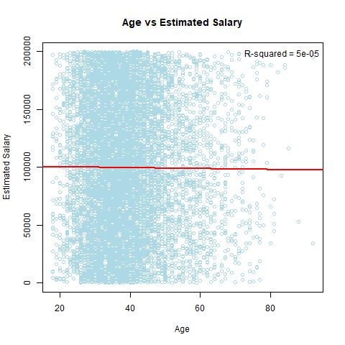
Linear & Multiple Regression
• Salary vs age: R² = 0.00005, no relationship
• Balance vs credit score, age & salary: R² ≈ 0.001
• These variables do not explain salary or balance

Slide 6
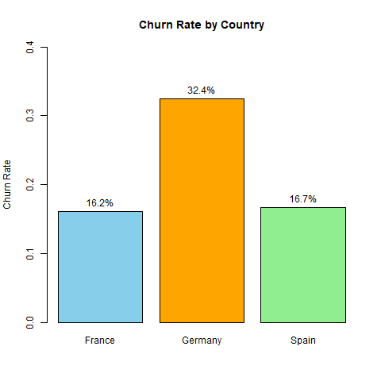
Churn Rate By Country
• Overall churn: about 20%
• Germany 32.4% vs France 16.2% and Spain 16.7%
• Inactive members churn more (27% vs 14%)
• Female customers churn more (25% vs 16.5%)

Slide 7
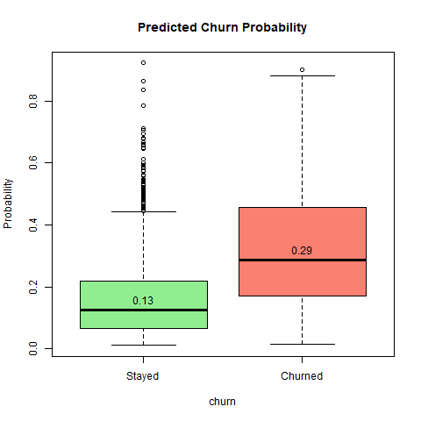
Logistic Regression Churn
• Target: churn (0/1); 80/20 train-test split
• Germany ≈ 2.2x odds of churn; each year of age +8%;
active members ≈ 65% lower
• Accuracy ≈ 82%, but recall only ≈ 25% at 0.5 cutoff
• A lower cutoff (0.3) catches more churners

Slide 8
Key Takeaways
• Age, credit score and salary do not explain salary or balance (R² ≈ 0)
• Germany has the highest churn, about double France and Spain
• Older, inactive customers are most likely to leave
• The model has about 82% accuracy but misses most churners; use a lower cutoff
• Target retention offers at older, inactive customers, especially in Germany

